Slide 1
Employee Salary Prediction
Done By: Dhruv Manoj
College: St Aloysius Deemed to be University
Department: Bachelor of Computer Applications(BCA)

Slide 2
Introduction
This project explores the use of machine learning to classify employees' income as above or below $50K based on demographic and employment features.
Dataset:
Adult Census Income
Models Used are:
Random Forest Classifier
Logistic Regression

Slide 3
Problem Statement
This project aims to build a machine learning model to predict whether an employee earns more than 50K annually based on demographic and work-related features.
It uses the Adult Census Income dataset and serves as a classification task to help organizations identify high-income potential employees using structured socio-economic data.

Slide 4
System Approach
System Requirements:
Python 3.11,
Jupyter Notebook
Libraries used are:
pandas,
numpy,
seaborn,
matplotlib,
sklearn,
joblib
Development Strategy:
Data cleaning and encoding
Feature engineering and scaling
Model training and performance evaluation

Slide 5
Algorithm & Deployment
Step-by-Step Procedure:
Load dataset
Handle missing values
Encode categorical columns
Train models: Random Forest & Logistic Regression
Evaluate performance metrics
Save models using joblib
Reload and predict with sample input
Visualize predictions using Seaborn

Slide 6
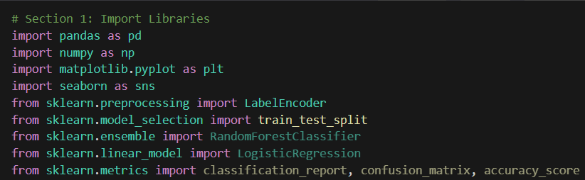
Screenshots of Code Snippets & Output

Slide 7
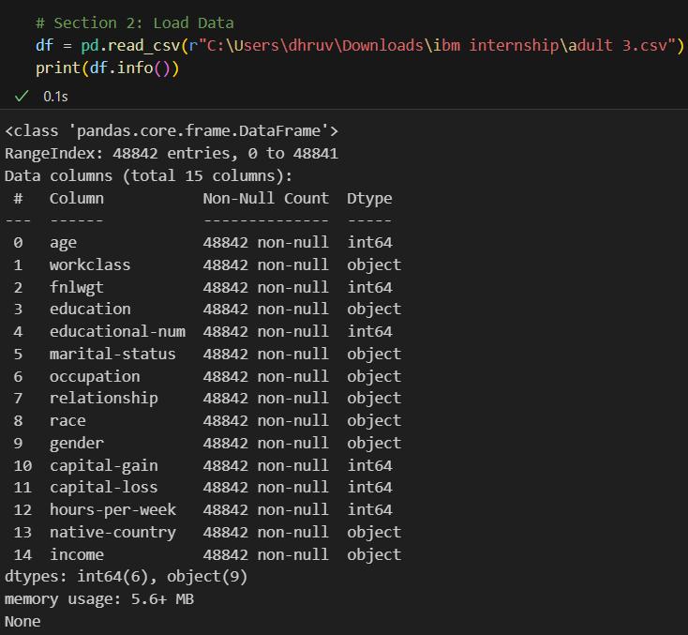

Slide 8
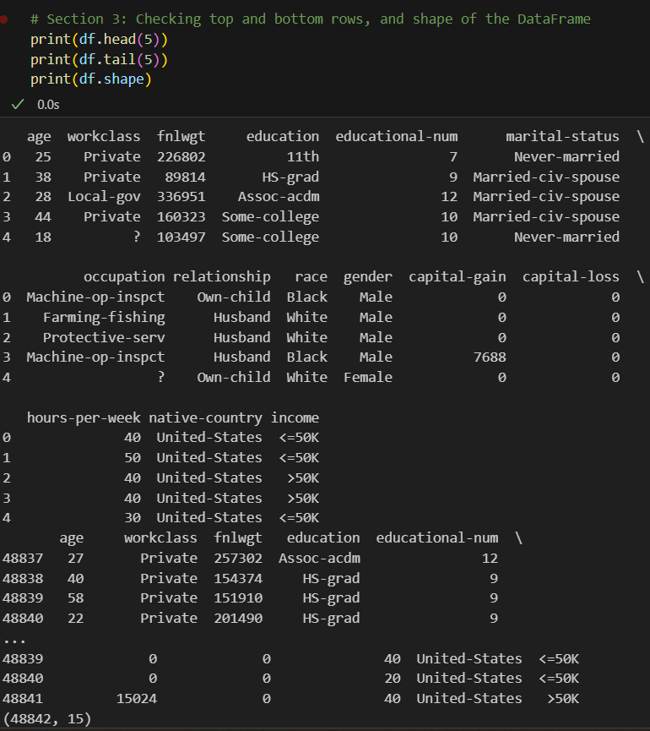

Slide 9
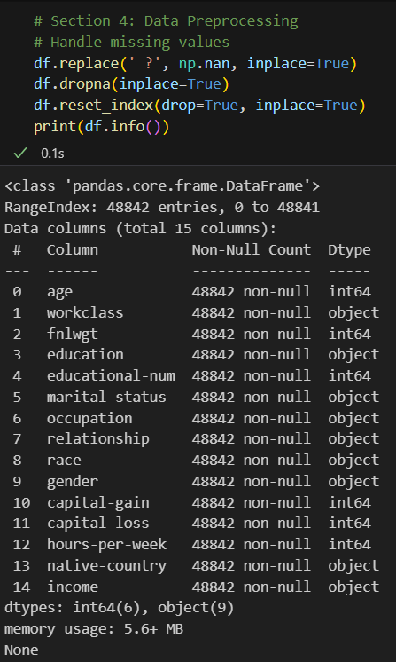

Slide 10
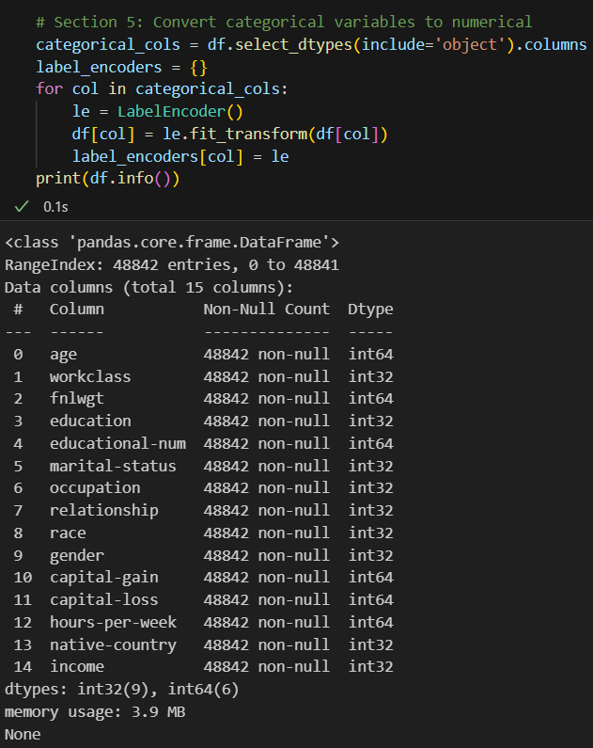

Slide 11
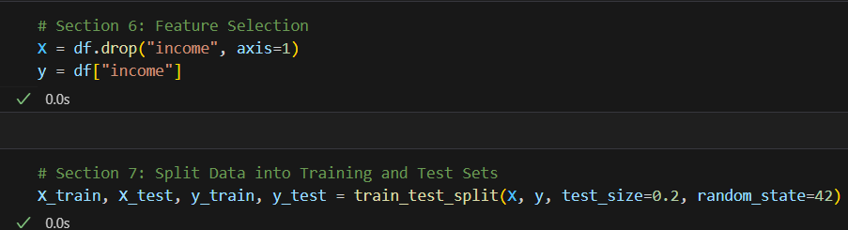

Slide 12
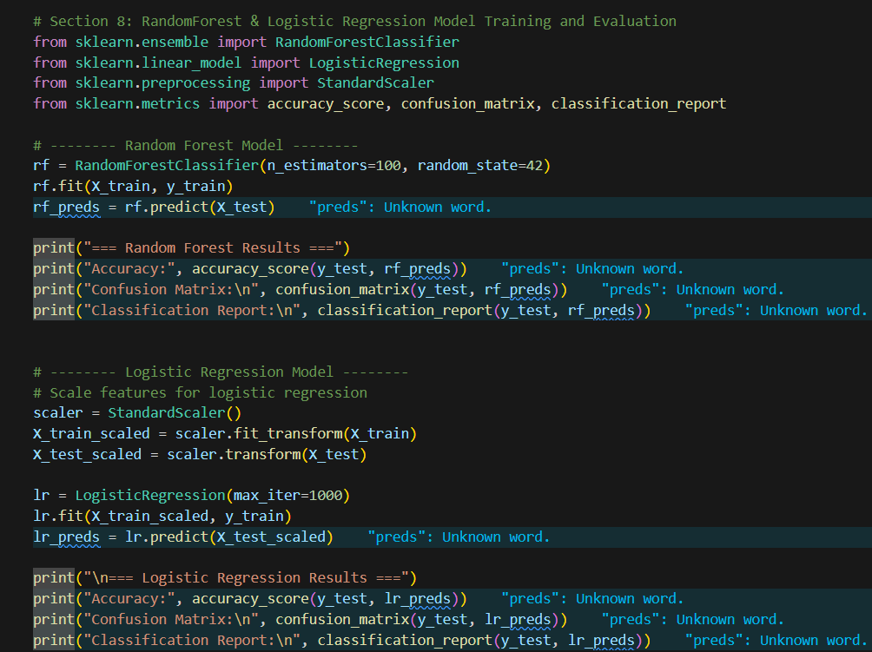
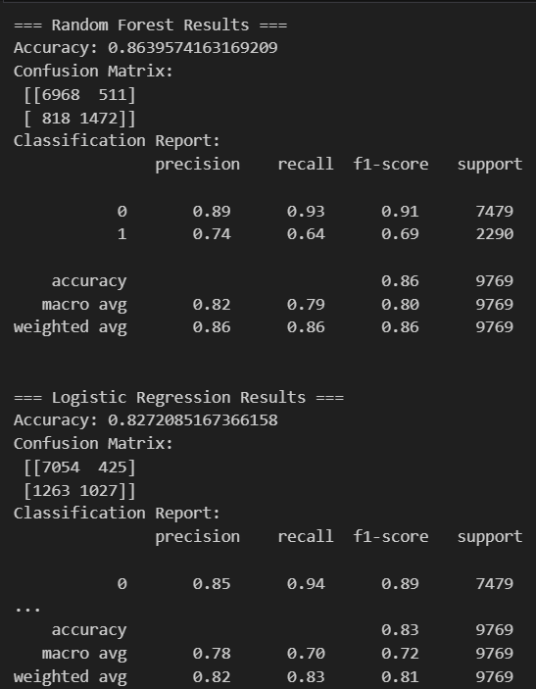

Slide 13
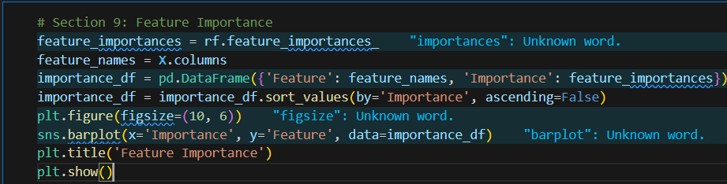
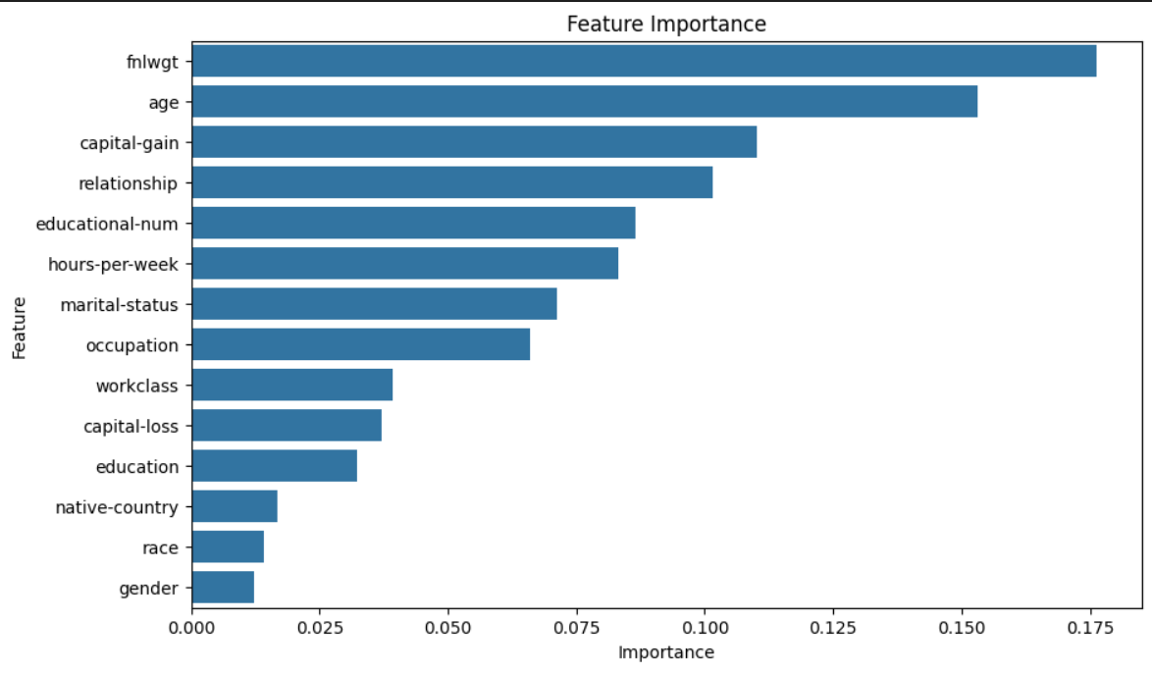

Slide 14
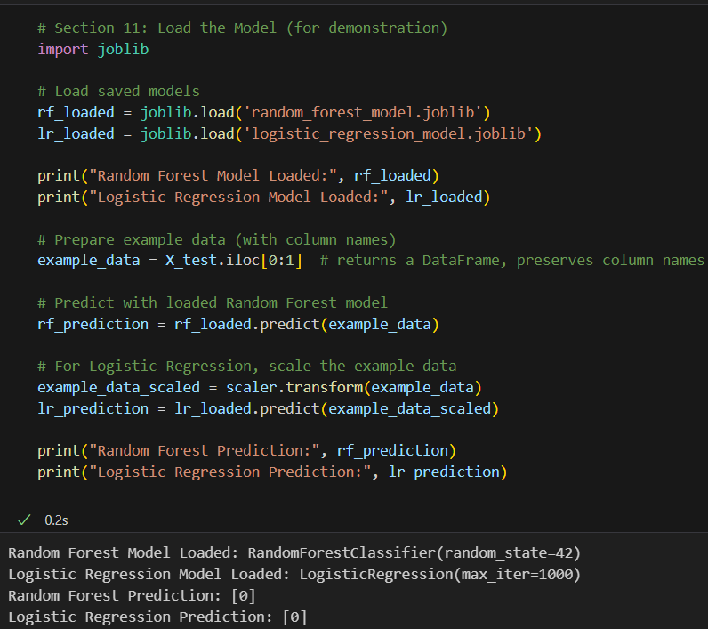
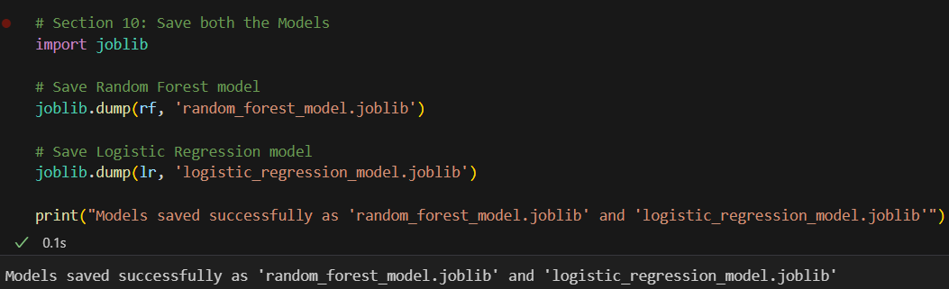

Slide 15
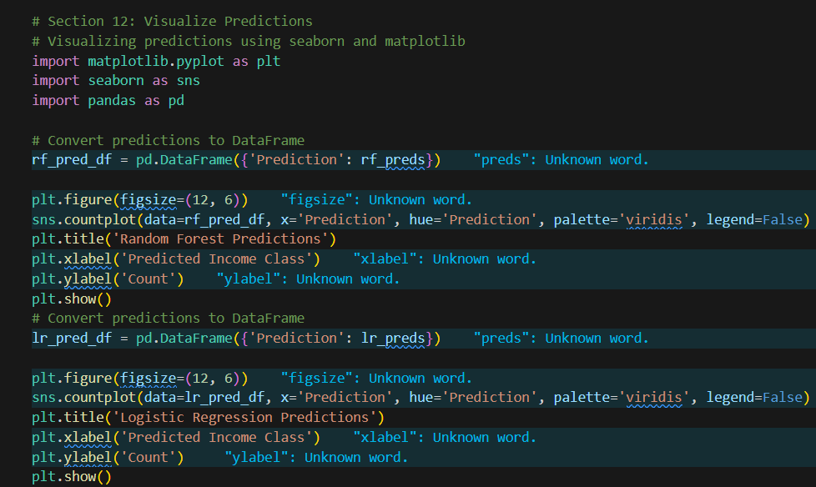
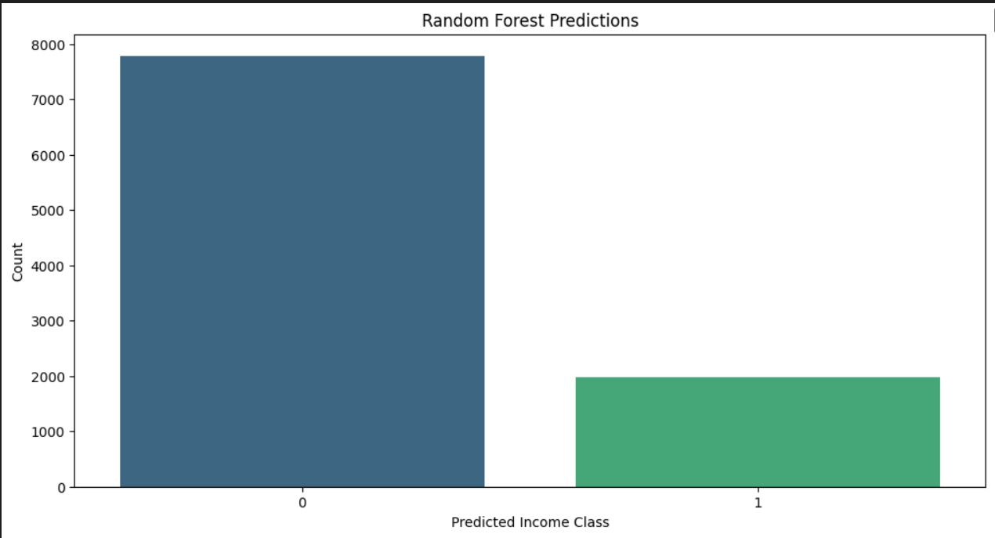
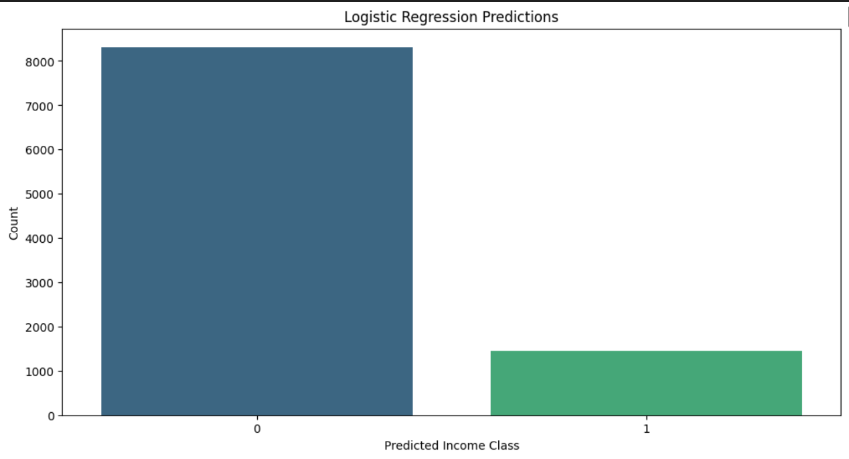

Slide 16
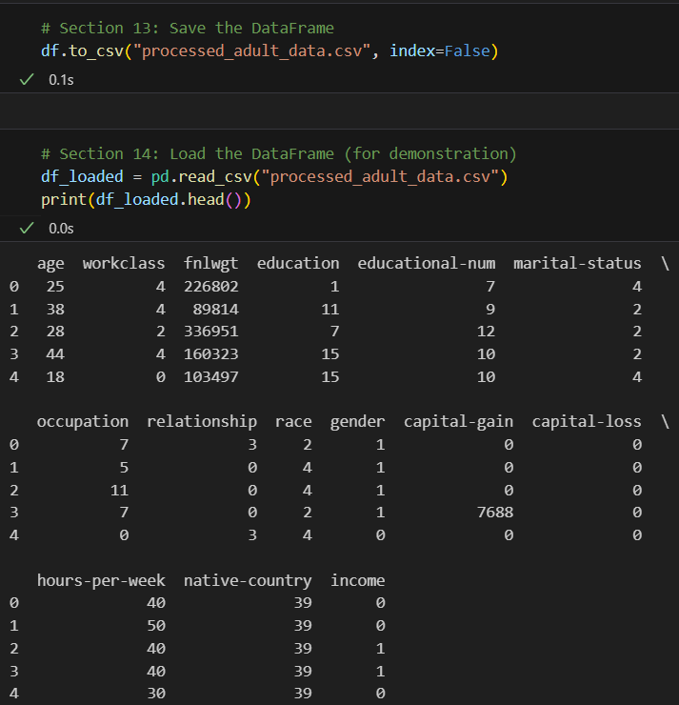

Slide 17
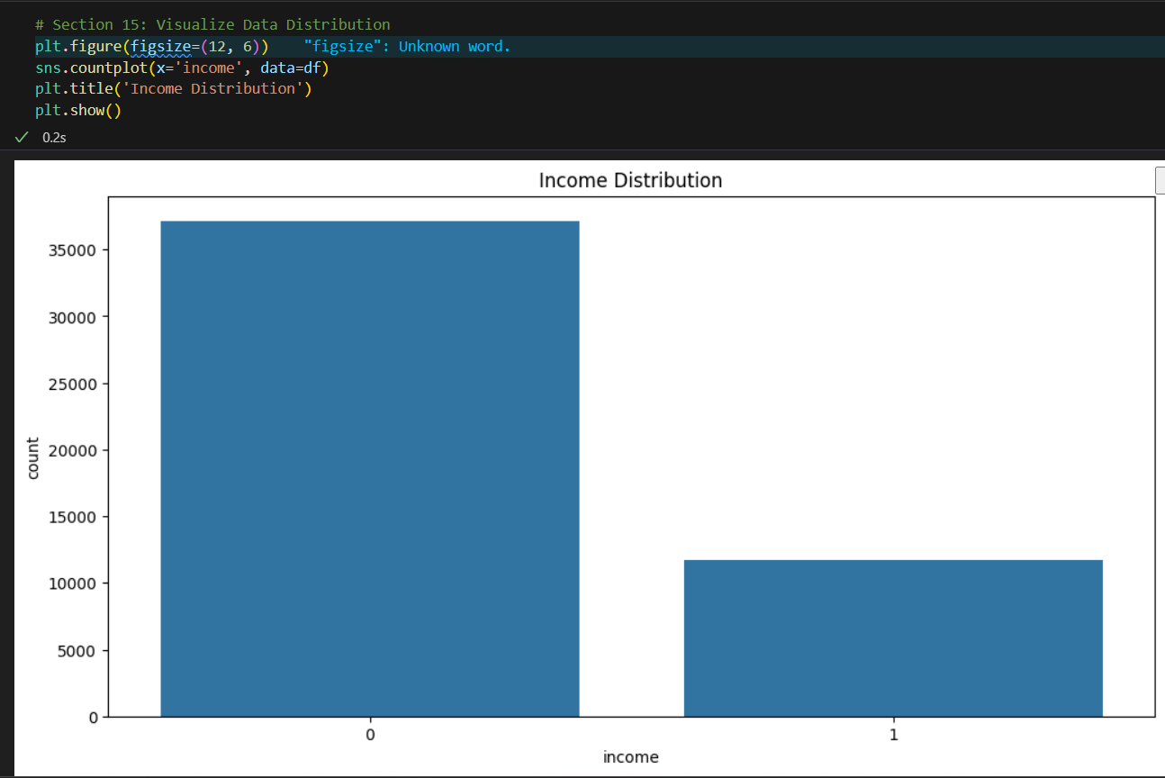

Slide 18
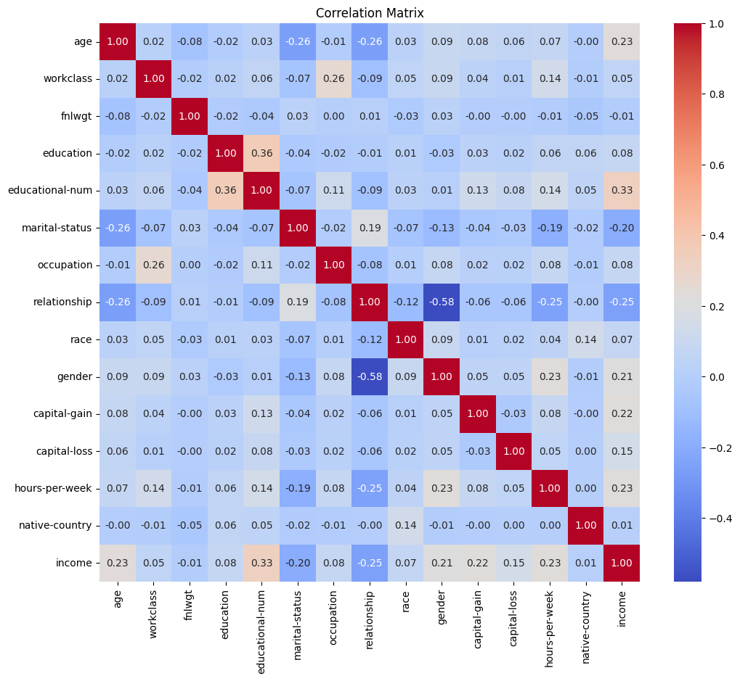
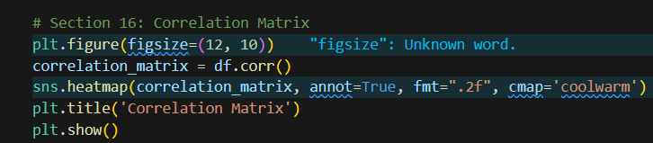

Slide 19
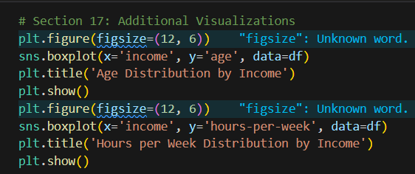
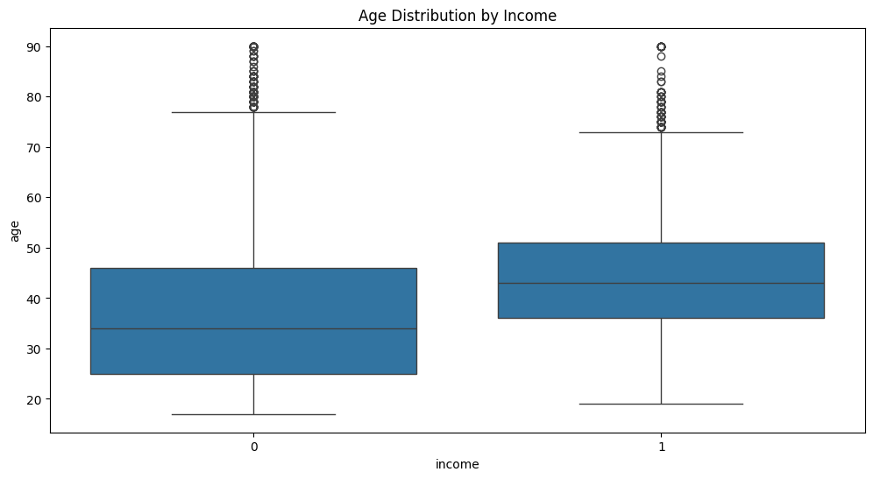
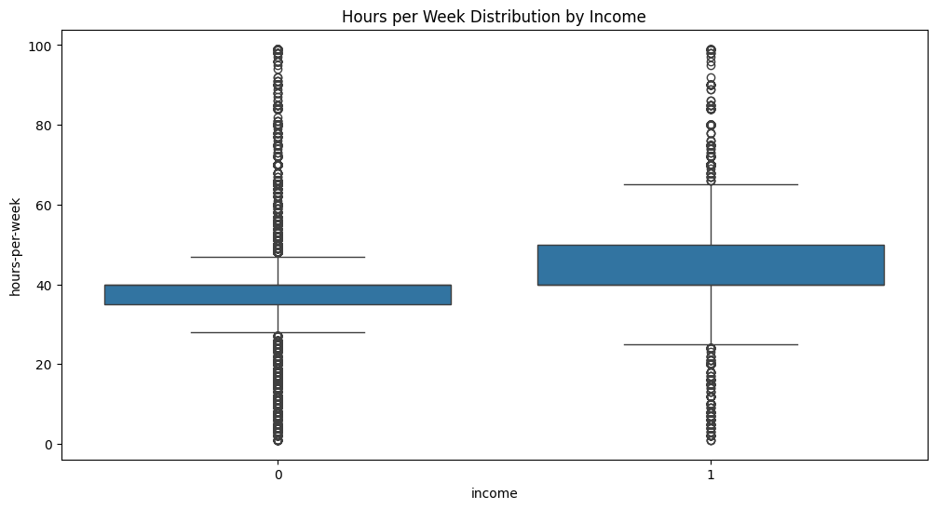

Slide 20
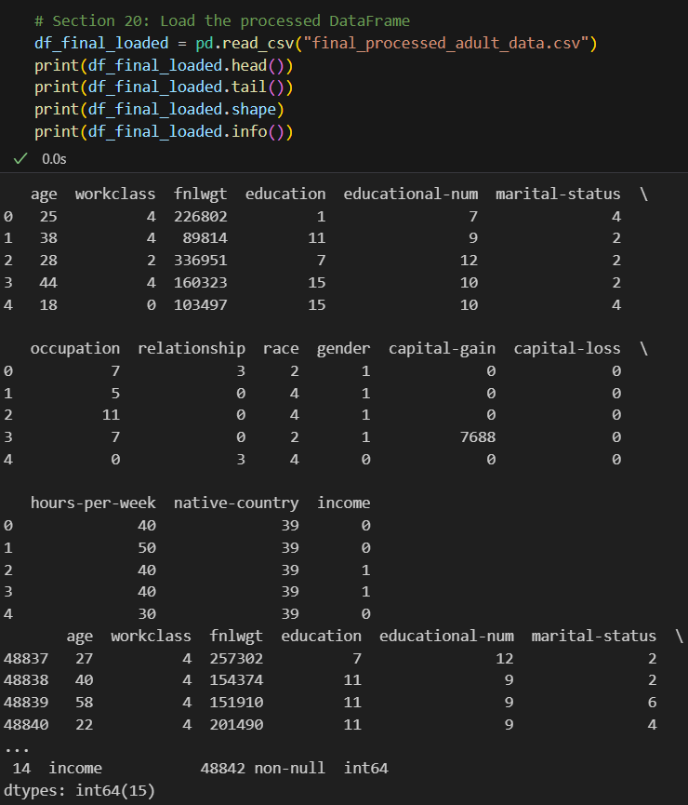
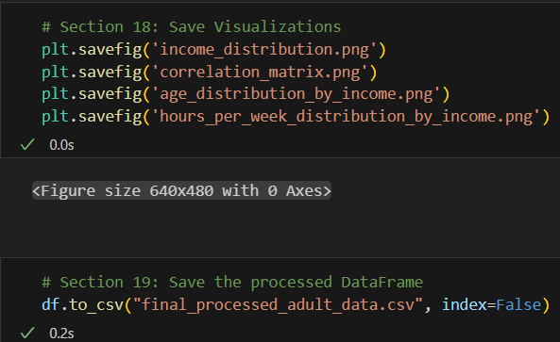

Slide 21
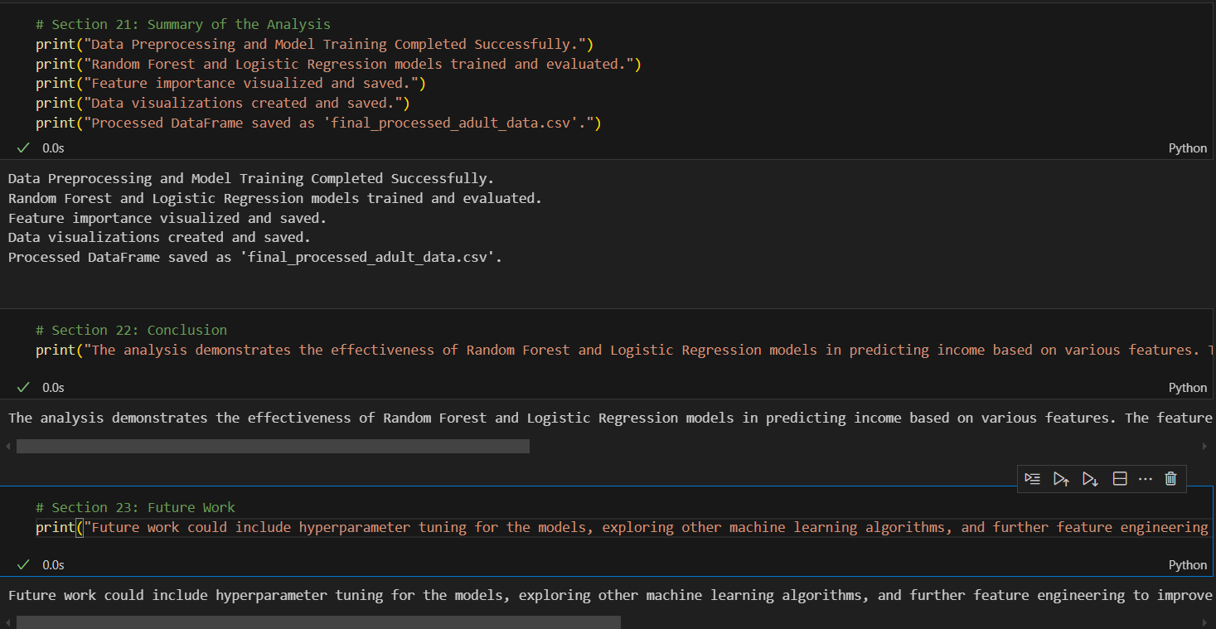

Slide 22
Conclusion
The Random Forest model achieved high accuracy and was easier to interpret, while Logistic Regression required scaling.
Both models performed well, and predictions could be made on unseen data. This model pipeline can be adapted to similar classification tasks.

Slide 23
Future scope
Use advanced models like XGBoost or LightGBM
Apply cross-validation for better generalization
Deploy as a web application with Flask or Django
Visualize feature importances using SHAP or LIME
Integrate real-time prediction capability

Slide 24
References
UCI Machine Learning Repository - https://archive.ics.uci.edu/ml/datasets/adult
scikit-learn Documentation - https://scikit-learn.org/stable/
pandas Documentation - https://pandas.pydata.org/
matplotlib Documentation - https://matplotlib.org/
seaborn Documentation - https://seaborn.pydata.org/
joblib Documentation - https://joblib.readthedocs.io/en/latest/
Python Official Docs - https://docs.python.org/3/
Real Python Tutorials - https://realpython.com/
Towards Data Science - https://towardsdatascience.com/
Analytics Vidhya - https://www.analyticsvidhya.com/

Slide 25
Summary
Dataset: UCI Adult Income
Binary Classification: >50K vs <=50K
Models: Random Forest & Logistic Regression
Preprocessing: Missing value handling, encoding, scaling
Evaluation: Accuracy, confusion matrix, classification report

